Slide 1
Eurobrands Consulting Pvt. Ltd.
(Eurobrands India)
COMPANY PRESENTATION
www.eurobrandsindia.com

Slide 2
Overview
About Eurobrands India
Eurobrands Growth M³ Services
Eurobrands Sector / Experience Matrix
Eurobrands Directors
Eurobrands Contact Details

Slide 3
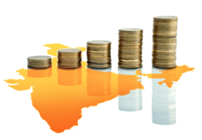
About Eurobrands
Growing YOUR Business in INDIA
Eurobrands provides customisable solutions for companies looking to grow their business in India. Utilising a comprehensive package of specialized services – from market research to marketing and sales support – Eurobrands brings products to the Indian market in the most efficient and cost effective way possible.
Eurobrands dedicated team of consultants, accountants, sales executives and industry experts has over the years created a transparent and direct line to India’s trade channels.
Eurobrands follows a three-step process to introduce its client’s product: Market Research, Market Entry and Market Expansion. This go-to-market strategy successfully concludes with Eurobrands handling or placing purchase orders, increase sales, margin and market share, while growing their clients brand into a truly global entity.
Eurobrands is based in New Delhi and its legal entity, infrastructure, local knowledge and specific sector expertise can be utilized by its clients to kick-start their businesses in India.

Slide 4
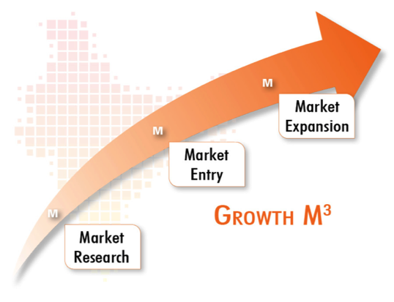
The Eurobrands Growth M³ Approach
The Eurobrands GROWTH M³ model is a strategic and long term approach to grow our clients business successfully in India.
The Eurobrands Growth M³ Services
M¹ > Market Research: Primary & Secondary Research
M² > Market Entry: Strategic Consultancy, HR, Legal & Tax Advise
M³ > Market Expansion: Import, Distribution, Sales & Marketing, Financial Planning
Advantages of appointing Eurobrands
Fullest transparency
Faster time to market
Freed up management time
Better access to information
Direct customer relationship in India
No high margins on product sales in India
Immediate feedback from the Indian market
100% ownership and control of the brand / venture
Adequate marketing activities

Slide 5
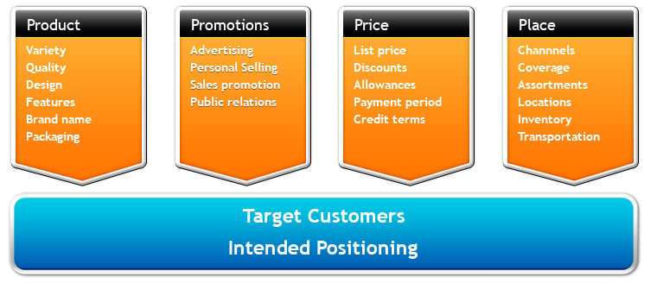
Services: Growth M¹ > Market Research
Eurobrands provides its clients all the relevant information about the Indian market. Eurobrands will assess the market potential of its clients in India.
The Services include primary and secondary market research as well as business and marketing research.
Focus on existing 4Ps (product, promotion, price, place) of competitors in India.

Slide 6
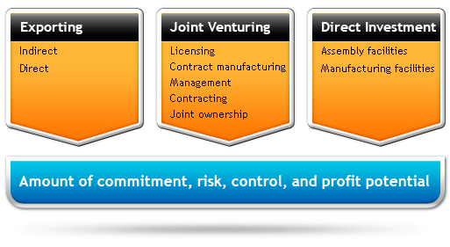
Services: Growth M² > Market Entry
Eurobrands identifies together with the client the best way to enter the Indian market. Eurobrands will build up the needed infrastructure, hire the local management and train the distribution and marketing partners.
Within one to two years our client’s business in India is likely to reach break even.
Selecting the best market entry strategy for each client in India.

Slide 7
Services: Growth M² > Market Entry
Organising of B2B Matchmaking Meetings for companies looking to export their products directly to Indian buyers. Eurobrands provides a full business-to-business relationship-building service that can develop contacts, supply lines and sales opportunities.
Incoming & Outgoing Trade Delegations visits for trade support institutions like chambers of commerce & embassies. The Eurobrands delegations help institutions and SMEs to identify opportunities and gaps in the market, find potential partnerships and explore the environment that they are entering.
Financial Advisory Services to help identify the best funding and growth opportunities. This service includes merger and acquisition advise / buy side advisory services like identification of potential target, definition of business strategy, financial and legal due diligence, negotiating the definitive agreements etc.

Slide 8
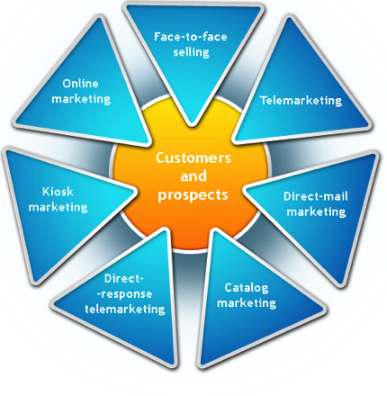
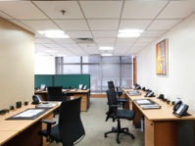
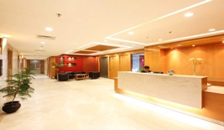
Services: Growth M³ > Market Expansion
Eurobrands supports the clients business during the stabilisation and expansion process.
Eurobrands helps to expand the clients business beyond the initial region and optimises the long term growth and return on investment.
Market Expansion Services include:
360 degree sales & marketing services
Dedicated Customer Relationship Management (leads, contacts, accounts, potentials, invoices, inventory, customized workflows)
Transparent expense and sales reports
Dedicated office space and secretarial services
Trade & Distribution platform
Warehousing and Logistics

Slide 9
Services: Growth M³ > Market Expansion
Business Planning & Company Structuring
Financial forecast (income / expenses planning) of the India operations
Calculation of Return of Investment (“ROI”) under consideration of various market scenarios
Tax and ownership structuring to optimise the resources within the parameters of the Reserve Bank of India
Recruiting Staff in India
Defining the right roles / positions the clients company will need in India including the tasks, responsibilities, targets and compensation
Present the clients company profile to potential candidates
Short-list candidates from our network and from applications received through job postings
Conduct a first round of interviews on the clients behalf
Arrange rounds of interviews together with the client (in India or by video conference calls) to select the best candidate together
Hire staff and provide the necessary legal framework (employment contract, employee tax payment, defining expense budget, holidays, insurances etc.)
Monitor the performance of the staff in India and monthly reporting to the client
Accounting & Bookkeeping
Handle and record all your financial transactions in India
Generate an accurate balance sheet, profit & loss account and cash flow statement
File relevant taxes with the Indian tax authorities on the clients behalf

Slide 10
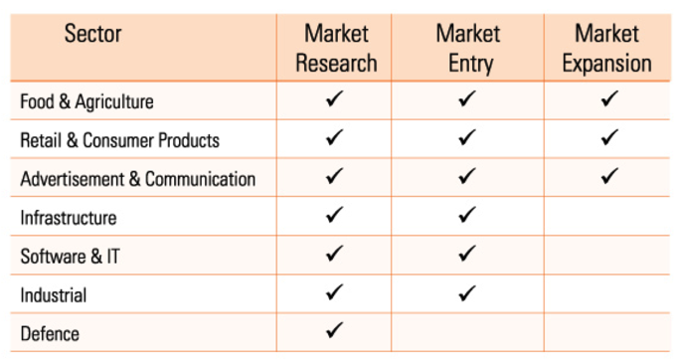
Eurobrands Sector / Experience Matrix

Slide 11
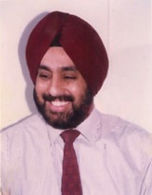
About Balbir Chhatwal
Balbir Chhatwal is the Executive Chairman of Eurobrands India.
He has been an entrepreneur and is focusing on early stage ventures in India.
He has over 25 years of leadership experience in Military, FMCG, Retail, Telecom, Agriculture sector and Consulting. He was the Country Sales Head India and South Asia for (Braun) Gillette operations in India. He also worked at PepsiCo as Vice President for Customer Development in India & South Asia. As a CEO of a leading retail player in USA, he spearheaded operations successfully and established a profitable ‘start up’ retail operation in India. He has a vast experience in profit center management, turn around & growth strategy, marketing & trade merchandising, distribution & supply chain management and excels in growing highly profitable businesses.
Balbir has an MBA from the University of Virginia, USA and a Bachelors of Commerce (Honors) from the University of Delhi. He is on the Board of CBC Trading LLP, which is helping Indian businesses to connect & interact with global businesses, by creating a new paradigm in this E-enabled world. He is also serving on the Board of CLJ Bio Tech Pvt. Ltd., wherein he is championing and promoting sustainable & inclusive growth in the agricultural sector of India, without compromising on the accelerated growth and is a mentor to several entrepreneurs in the consumer services and agriculture sector in India.

Slide 12
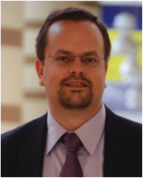
About Andreas De Rosi
Andreas De Rosi is the Managing Director of Eurobrands India.
Prior to starting Eurobrands he worked as Senior Business Analyst with Evalueserve - the global leader in the knowledge process outsourcing based in Gurgaon, India.
Before that he worked in Italy with various international trade promotion organisation including “Indexport”, a cooperative with over 100 SME member companies based in Bolzano, Italy. As a international trade & marketing consultant, Andreas assisted many European companies during their market entry into India covering various sectors like interiors, construction machinery, agricultural equipment, food and beverage products and industrial applications. Over the years Andreas has developed strong ties to international trade institutions, SMEs & global companies both in Europe and India and was advising the Commercial Section of the Indian Embassy in Rome on international trade & FDI matters.
Andreas holds a master degree in International Economics and Business Studies from the University of Innsbruck, Austria and Bradford, England.
He is an Italian national, has an Indian wife and is a resident of New Delhi for the past 6 years. He speaks fluent English, German, Italian and Norwegian.

Slide 13
CONTACT EUROBRANDS
Eurobrands Consulting Pvt. Ltd.
212 Shahpur Jat
2nd Floor
New Delhi – 110049
Level II – Elegance Tower
Jasola District Centre
New Delhi, 110029
P: +91-11-4051 9481
F: +91-11-4051 9482
Our Memberships
www.eurobrandsindia.com
info@eurobrandsindia.com
www.fb.com/eurobrands
© 2010 Eurobrands Consulting Pvt. Ltd. All rights reserved.

